Slide 1
System Calls
Presented By:
Komal S. Kallanagoudar

Slide 2
Presentation Outline
What are system calls
How system calls are used
Types of system calls

Slide 3
What are System calls
System call provides interface to services made available by an operating system.
Written in high-level language(C or C++).

Slide 4
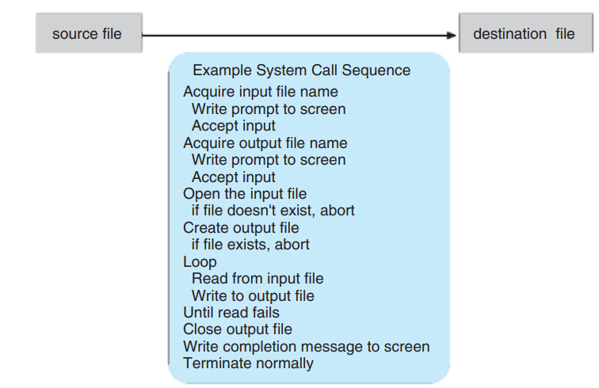
How system calls are used
Example : How system calls are used.

Slide 5
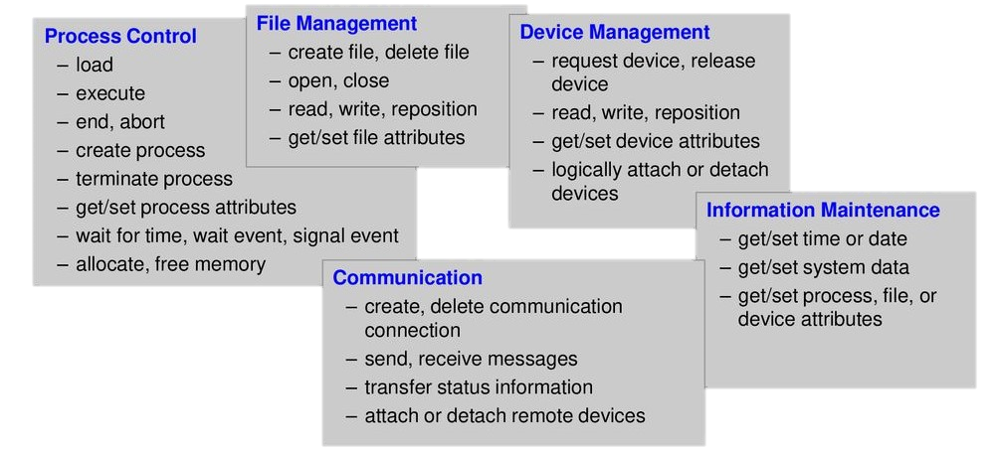
Types Of System Calls

Slide 6
Thank You

